Slide 1
Study Abroad
…………………………….
Email: study_abroad@slc.co.uk

Slide 2
Charmaine Valente
Introduction to the Student Loans Company Study Abroad administration and information and guidance session
Notes:
Welcome to the Study Abroad webinar.
A bit of housekeeping: Please keep stay on mute until we break for questions. You can ask questions while we are presenting as we have two wonderful colleagues, monitoring the chat function and they will do their best to answer your questions. These will be taken away made into an FAQ.
We will be in touch shortly after all the sessions have completed, to inform you where we will hold the presentations and FAQs. We are not recording this session.
I wanted to reiterate that SFW provides the same study abroad service as SFE however, SFW is dealt with by SFW study abroad team. We have added a slide on this within this session. As I have explained and reiterated within the session invitation, this is mainly for SFE students.
This session will start with the Study Abroad Team explaining the administration process to enable your students to receive their funding on time, with a Q&A. Then we will have a short comfort break. When we restart, I will run through information and guidance your students need to know which will help ensure your student apply correctly.
Please, leat me introduce you to Andrew Matthews who is going to present the study abroad administration process.

Slide 3
Study Abroad Assessors
Our team consists of 5 core assessors who’s work specifically includes student finance study abroad applications
Andrew Matthews
Charlene Hind
Megan Ham
Sue Connor
Laura Coates
Email: study_abroad@slc.co.uk
Notes:
5 members who are in a team of other assessors who have many duties, one of which is study abroad .

Slide 4
Study Abroad Assessors
The Study Abroad Team was created to assist students who will be studying or working abroad throughout the academic year who require their student finance entitlement to be paid outside of the standard instalment structure/payment dates
Our main priority is to process manual payments for students who require their payments outside of the standard instalment structure, based on information provided by the HEPs. We are also here to assist HEPs with any study/work abroad queries which are not easily resolved using the guidance materials provided either by us or through the practitioner website

Slide 5
Study Abroad Process & Evidence – Core Assessing
When a student indicates that they will be studying abroad for all or part of the academic year:
Assessor will check the study abroad spreadsheet - ‘HEP confirmation’ in the first instance.
If this does not confirm then they will check to see if we have received a CAB form or a letter from the HEP
The university website can also be used to confirm that the course they are on offers study abroad. If the study abroad option is confirmed, then the application can be assessed as such
If a study abroad period cannot be confirmed, then the application will be assessed as though they are at their home university for that period and the student will be sent an email requesting the university confirm the study abroad dates by providing confirmation electronically on the study abroad spreadsheet or alternatively either a CAB form or a letter confirming the study abroad dates
Notes:
This is the process a standard core assessor would take if presented with an application from a student who has indicated they are going abroad.

Slide 6

Placement Abroad
Work placements abroad are not classed as study
These are not awarded the abroad rate of maintenance loan. These students are entitled to the reduced rate of maintenance loan
The only work placements abroad which would receive the abroad maintenance loan would be students in receipt of Turing funding
Notes:
Mention that for SFE purposes, the student is either ‘studying abroad’ or they on a ‘work placement abroad’. We do see the term ‘ study placement abroad’ Please do not put study and placement in the same sentence/context as this can result in the wrong funding being awarded by the core assessing teams.
TURING – This has a massive impact on how much a student can receive in student finance.
We recommend that students say ‘NO’ to the Turing question on their applications until they know they have been accepted for Turing.
We also recommend that you do not use any Turing drop down on the spreadsheet until you know that Turing is awarded to that student.

Slide 7
Manual Payments Offered
We offer three types of manual payments to assist students who are studying (or on placement) abroad
These are:
First Instalment paid early
Full Entitlement paid in two instalments
Full Entitlement paid in one instalment
A student can request one of the manual payments providing we have confirmation of the study abroad or placement from their HEP and that the student is in a country eligible for that request
For 1 and 2 instalments, early payment can also be requested

Slide 8

First Instalment Paid Early
The system automatically pays 25 days prior to UK term 1 start date for any student who is abroad in term 1. If payment is required prior to this, student will be accepted for early payment
Requirements:
No restriction, provided the student is abroad in term 1

Slide 9

Full Entitlement Paid In Two Instalments
Requirements:
50/50 Split
Countries outside Europe
Full Year Abroad
33/67
Term 1 in United Kingdom or Europe
Terms 2 and 3 In a country outside of Europe

Slide 10

Full Entitlement paid in one instalment
Requirements:
Full Year
Countries: China. Japan, Russia and South Korea

Slide 11
Common Reasons Manual Payments are Rejected
Requesting 1 or 2 instalments for a country not eligible for those instalments
Not abroad for eligible period
Abroad details not fully supplied
SAAS, SFNI and EU student
Early payments within 25 days
UK Placements only – I.E. No periods abroad
More detail will be covered in the scenario presentation we have planned
Notes:
We have just covered what payments we offer.
We will now quickly cover why would reject a request.

Slide 12
How to request a manual payment
A completed “Study Abroad Template” spreadsheet sent to the designated SFE Study Abroad inbox (study_abroad@slc.co.uk) (We recommend using this method as we will be able to deal with the requests much quicker)
A Course Abroad (CAB) Form sent to the Darlington postal address. If the student wishes to request a manual payment, then there MUST ALSO be a note/separate letter with the CAB form that states the type of payment being requested
A letter sent to the Darlington postal address detailing where the student is studying (or on placement), the dates this will take place and the tuition fees charged. When the student is requesting a manual payment, it must be stated either on the HEP letter or on an accompanying cover letter

Slide 13
What happens next?
CAB Form or HEP letter
If a CAB Form or HEP Letter has been sent via the post, then these will be worked by our Core Processing department and if a manual payment is stipulated then the details will be passed to the study abroad team internally so that the account can be reviewed
If there is no request for any manual payment provided with the CAB form/HEP letter, then the student will be paid in the standard 3 instalments
Notes:
Mention the timings of the process. Peak times 2 to 4 weeks

Slide 14
HEP Spreadsheet
Launch of the AY – we send a bulk email to HEPs with the spreadsheet template. Also, HEPS can email the study abroad team to get this spreadsheet any time of the year
Needs to be a fully completed spreadsheet
Include all your SFE students that are going abroad on the spreadsheet
Notes:
Just want to add that you can send multiple sheets throughout the year as and when you have information.

Slide 15
HEP Spreadsheet
Excel document for HEPs to use for sending over their students on study abroad
First Tab – HEP guidance. This covers:
What the study abroad team do
Manual Payments Offered
First Instalment early
Full entitlement in two instalments
Full entitlement in one instalments
Alternative requests
How students can request manual payments
What happens next
CAB forms / HEP letters
Spreadsheets
Reassessments
FAQ / Miscellaneous
Second Tab – Student Scenario Index. This will give you an idea of what your student is entitled to, based on their circumstances
Third Tab – Guide on how to complete the “HEP spreadsheet”
Fourth Tab – 25 days early payment calculator. This shows if the system will automatically calculate early payments for your student
Fifth tab – This section is where you will add your students details for their study abroad year which we will the use for entitlement and payment plans
Notes:
What does the template include?

Slide 16
Completing HEP Spreadsheet
We are going to go over some basics regarding the completion of the spreadsheet template
When completing, please remember the spreadsheet is formulated to assist us arrange manual payments for your students
please ensure you use the ‘paste values’ function in excel to ensure the data does not corrupt any formulas

Slide 17
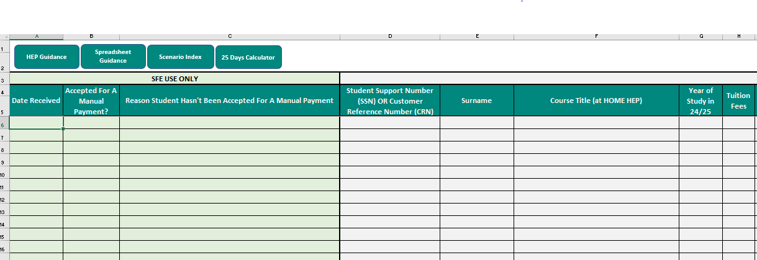
HEP Spreadsheet
Notes:
This is a screen shot of the first few cells on the template.
Nothing really different to previous years.
The first 3 columns are for our use, so please leave these blank.

Slide 18
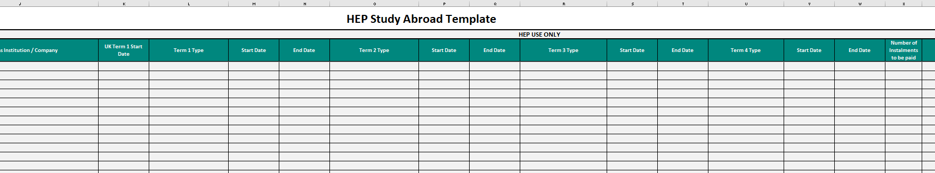
HEP Spreadsheet
Number of instalments
Term Type
.
Notes:
The cells are pretty much self explanatory with what information is required.
I just want to cover the 4 term types and dates.
We have 4 terms listed, just to cover all options. The vast majority will be 2 term dates. i.e. August to December and January to May. Just complete the terms that are appropriate.
TURING. Only indicate Turing study or placement if the student has been accepted for Turing please. You can always advise us later when Turing has been awarded. We Recommend that students say ‘NO’ on their applications to Turing until they know that they have been accepted. Especially important for those on Placements.
Don’t forget column x and the number of instalments required. If left blank, then we will pay in the standard 3 instalments

Slide 19
Submitting Spreadsheet
As advised last year, the new GDPR rules came into play
When you submit the spreadsheet, you must password protect this with your 4-digit HEP code
A help guide was issued with the 24/25 launch documentation
Should you be unaware of your HEP code, please speak with your registration team, Course admin team or Student record team
Notes:
Some of you had issues with the HEP code as its not something you are aware of, however your teams that deal with COC submissions or updating Course Management System ( cms) will know exactly what this is as it’s a way of identifying your university to SFE. - Registrations, Course admin team, Student records.- whatever you call your teams at your HEP.

Slide 20
Communication to the student
Students will continue to receive their standard notification of entitlement letter and can view their payment dates online. The system will still schedule the student's payments as per the UK course term dates
In order to ensure the student receives the correct information, we will send communication via email to all students who have been accepted for one of our manual payments. This will inform them that we have received their request from their HEP, accepted this request, and what will happen next
We will then issue a further email once their application is fully approved, which will confirm their payment dates
Notes:
So, when a student comes to you and asks what's happening, you can redirect them to the emails that we have sent out.
Since we introduced this a few year back, we noticed a vast reduction in queries from yourselves as the student had been made aware of what we will do.
However, if the student is adamant that they have not heard anything, then just drop us an email and will confirm to you what the situation is.

Slide 21
How you can help us
Promote early applications from the students
Submit information as soon as practical – HEP spreadsheet.
Prioritise Students Requiring Manual Payments
Any changes notified via email as soon as possible

Slide 22
Common Requests
You have been asked for a CAB form when you have already submitted details via a spreadsheet
Student has contacted us stating that their funding is incorrect
We are here to help:
Email us at study_abroad@slc.co.uk
Notes:
Either TG team require or an assessor has requested this and not realised we already have the spreadsheet.
In either case, just drop us an email and we will investigate for you. We will clarify if anything is required from you.

Slide 23
Withdrawals/Suspensions
You will have students who change their minds or external forces will create challenges
Email us the details as soon as you can.
Students deciding to stay at university for the year
Students returning to the UK during the year
Students suspending their studies during the year
Not informing us of any changes can result in students being in an overpayment.
If suspending for the rest of the year or withdrawing from the course, please send the usual COC
Notes:
If a student actually withdraws or suspends their studies, please submit the usual COC as we need this for audit purposes.
If its just a matter of the student returning to UK and continuing to study at your HEP, then an email will be just fine.

Slide 24
RECAP
What Manual Payments we offer
The difference between Study Abroad and a Work Placement abroad and the effect of Turing
How to request manual payments
A quick look at the Spreadsheet content
How to submit with the Passcode
Keeping us in the loop with changes
Notes:
Summary of the main points presented today

Slide 25
SFW Study Abroad
Offer same manual payments and process
HEP spreadsheet still the same – use the same one from the bulk email sent by SFE
Send spreadsheet back but to: sfw_sfo2@slc.co.uk
Notes:
Please note that the SFW email address has changed for this year

Slide 26

Question time
Email: study_abroad@slc.co.uk

